Slide 1
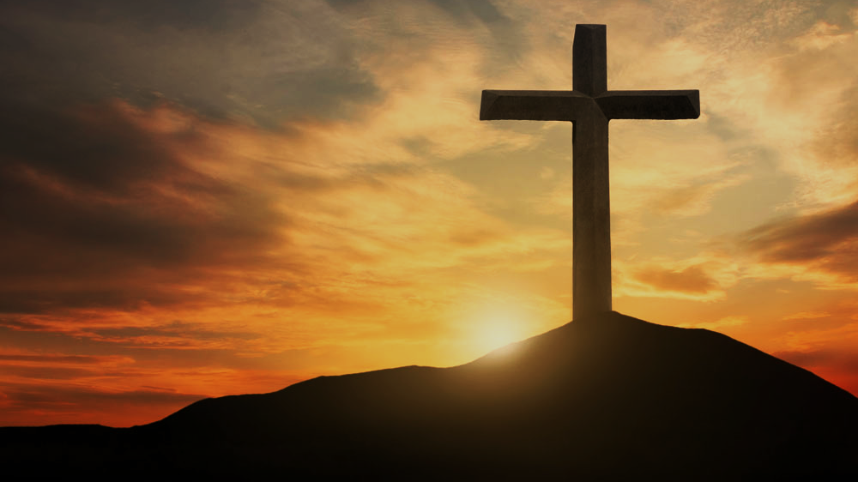
Doctrine of Salvation (Soteriology)
Wednesday Bible Study
Faith Presbyterian Church

Slide 2
Ordo Salutis
Election
Predestination
Calling (external and effectual)
Regeneration
Repentance
Saving Faith
Justification
Adoption
Sanctification
Glorification
Eternity
Single Act
Personal History
Process
Fullness of Time

Slide 3
What is Justification?
It is the act of God imputing Christ’s justice upon the regenerated elect.
It means their past, present, and future sins are forgiven. God treats them as righteous and will never bring their sins against them (Romans 3.21-31).

Slide 4
Double Imputation
Christ’s work in favor of the elect accomplished “obedience and satisfaction” for them. These are two distinctive actions. One of them undoes what Adam did and the other does what he did not do. They are commonly called the “passive and active obedience of Jesus”.

Slide 5
Double Justice of Christ
Eternal Life
Obedience
Active Obedience
What Adam did not do
Rom 5.8-19
1 Tim 2.6
Heb 10.10,14
Mat 3.15; 5.17
Phi 2.8
Adam’s Original State
Death
Passive Obedience
Undoing what Adam did
2Cor 5.19-21
Rom 3.24-25
Eph 1.7; 5.2
John 10.11,14-17, 26-29
Sinful State

Slide 6
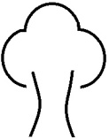
Justification In Relation to the Testaments
1ª Coming of Christ
2ª Coming of Christ
Daniel 9.24-26
Isaiah 53.4-6, 10-12
*
Antigo
Testamento
Novo
Testamento
Justified by Faith in future justification
Justified by Faith in Christ’s Accomplished Work
Eden
Covenant of Works
Covenant of Grace

Slide 7
CONFESSION OF FAITH
Chapter 12
Paragraph 1
All those that are justified, God vouchsafeth, in and for his only Son Jesus Christ, to make partakers of the grace of adoption, by which they are taken into the number, and enjoy the liberties and privileges of the children of God, have his name put upon them, receive the Spirit of adoption, have access to the throne of grace with boldness, are enabled to cry, Abba, Father, are pitied, protected, provided for, and chastened by him, as by a father: yet never cast off, but sealed to the day of redemption; and inherit the promises, as heirs of everlasting salvation.

Slide 8
Teaching on Adoption
1. Adoption is a gift of grace not a right
2. Adoption is worked by the Holy Spirit
3. By adoption children of wrath become children of God with all the privileges of an heir
4. Adoption cannot be reversed

Slide 9
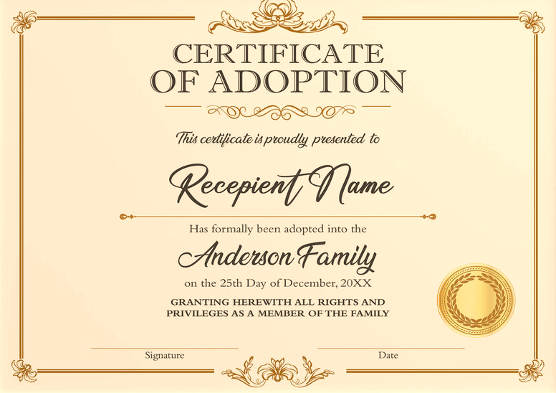
1. Adoption is a gift of grace not a right
Not all are children of God (Eph 2.3; Rom 3.23; John 8.41-44).
It is God who gives the gift (Eph 1.5).
It is not based on merit.

Slide 10
2. Adoption is worked by the Holy Spirit
The holy Spirit works in hearts to assure by faith those who are children of God (Gal 4.4-6).
They can call him Abba, father (Rom 8.15; 1John 4.18).

Slide 11
3. By adoption children of wrath become children of God with all the privileges of an heir
God treats them as his beloved children (Rom 8.17; John 1.12; Jer 14.9; 2Cor 6.18; Rev 3.12)
They have access to him, to the “throne of grace” (Eph 3.12; Rom 5.2; Heb 4.16)
God provides and protects them (Psa 103.13; 27.1-3; Prov 14.26; Matt 6.30,32; 1 Pet 5.7)
God chastises them lovingly for their correction (Heb 12.6).

Slide 12
4. Adoption cannot be reversed
God will never cast off those whom he adopted. There is nothing they can do that can separate them from him. They are justified (Lam 3.31-32; Heb 13.5)
The children were sealed for the day of redemption (Rom 8.23).

